Slide 1
Data Modeling Using the Entity-Relationship (ER) Model
Chapter - 2
Notes:
Entity-Relationship (ER) model, which is a popular high-level conceptual data model. This model and its variations are frequently used
for the conceptual design of database applications, and many database design tools employ its concepts

Slide 2
Outline
Overview of Database Design Process
Example Database Application (COMPANY)
ER Model Concepts
  Entities and Attributes
  Entity Types, Value Sets, and Key Attributes
  Relationships and Relationship Types
  Weak Entity Types
  Roles and Attributes in Relationship Types
ER Diagrams - Notation
ER Diagram for COMPANY Schema
Notes:
serious medical condition that affects an individual’s thoughts, feelings, mood, and behavior
Mental illness in the U.S., Canada, and Western Europe ranks first among illnesses that result in disability.
Worldwide, someone commits suicide every 40 seconds. About 1 million die by suicide every year. (WHO, 2012)

Slide 3
Overview of Database Design Process
Conceptual modeling - a very important phase in designing a successful database application
Two main activities
  Database design
  Applications design
Focus in this chapter on database design
  To design the conceptual schema for a database application
Applications design focuses on the programs and interfaces that access the database
  Generally considered part of software engineering

Slide 4
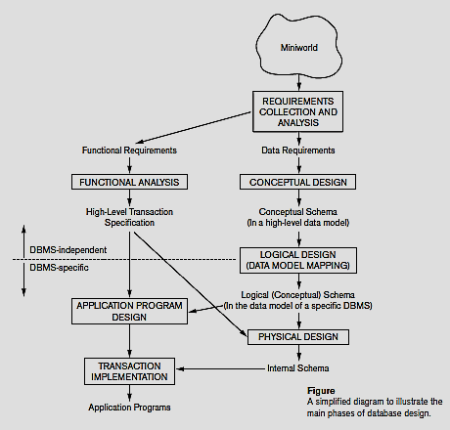
Overview of Database Design Process

Slide 5
Entity-Relationship Model
Conceptual (high-level) data models
Provide concepts that are close to the way many users perceive data. (Also called entity-based or object-based data models)
Entity-Relationship model (ER) - a high-level description of the structure of the DB
The Entity-Relationship Diagram (ERD) is a graphical model for representing the conceptual model for the data
ER models the DB using three element types
  Entities
  Attributes
  Relationships

Slide 6
A Sample Database Application
Create a database schema design based on the following (simplified) requirements of the COMPANY Database
COMPANY database keeps track of a company’s employees, departments, and projects
  The company is organized into DEPARTMENTs. Each department has a name, number and an employee who manages the department. We keep track of the start date of the department manager. A department may have several locations.
  Each department controls a number of PROJECTs. Each project has a unique name, unique number and is located at a single location

Slide 7
A Sample Database Application
  We store each EMPLOYEE’s social security number, address, salary, sex, and birthdate
    Each employee works for one department but may work on several projects.
    We keep track of the number of hours per week that an employee currently works on each project.
    We also keep track of the direct supervisor of each employee
  Each employee may have a number of DEPENDENTs
    For each dependent, we keep track of their name, sex, birthdate, and relationship to the employee

Slide 8
ER Model Concepts
Entities
  are specific objects or things in the mini-world that are represented in the database
  An entity may be an object with a physical existence
    For example, a particular person, car, house, or employee) or
  It may be an object with a conceptual existence
    For instance, a company, a job, or a university course
Attributes
  are properties used to describe an entity
    For example, an EMPLOYEE entity may be described by the employee’s name, age, address, salary, and job

Slide 9
ER Model Concepts
  A specific entity will have a value for each of its attributes
    For example, a specific employee entity may have
    Name ='John Smith',
    SSN ='123456789',
    Address ='731, Fondren, Houston, TX',
    Sex ='M',
    BirthDate ='09-JAN-5’
    Each attribute has a value set (or data type) associated with it
      e.g. integer, string, subrange, enumerated type, …

Slide 10
Types of Attributes
Simple
  Attributes that are not divisible are called simple or atomic attributes
    Example : SSN, Salary
Composite
  attributes can be divided into smaller subparts, which represent more basic attributes with independent meanings
  The attribute may be composed of several components
  Example
    Address(Apt#, House#, Street, City, State, ZipCode, Country)
    Name(FirstName, MiddleName, LastName).

Slide 11
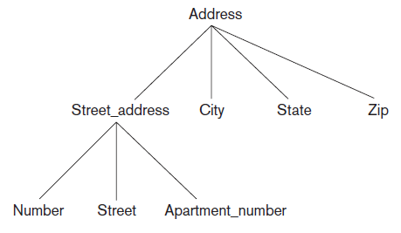
Types of Attributes
  Composition may form a hierarchy where some components are themselves composite
Figure : A hierarchy of composite attributes

Slide 12
Types of Attributes
Single-Valued
  Most attributes have a single value for a particular entity
  Example : Age is a single-valued attribute of a person
Multivalued
  An attribute can have a set of values for the same entity
  Example : College Degrees of a PERSON, Phone number
Stored versus Derived Attributes
  In some cases, two (or more) attribute values are related
  For example, the Age and Birth_date attributes of a person
  Age can be determined from the current (today’s) date and the value of that person’s Birth_date
  Age - Derived attribute, Birth_date - Stored attribute

Slide 13
Types of Attributes
NULL Values
a particular entity may not have an applicable value for an attribute (not applicable)
  Example – Apartment Number, College degrees
  For such situations, a special value called NULL is created
NULL can also be used if we do not know the value of an attribute for a particular entity (unknown)
  For example, if we do not know the home phone number of ‘John Smith’
Unknown category – classified into two cases
  First case - when it is known that the attribute value exists but is missing – Example : Height attribute
  Second case - when it is not known whether the attribute value exists – Example : Home phone number

Slide 14
Types of Attributes
Complex Attributes
  In general, composite and multivalued attributes can be nested arbitrarily to any number of levels, although this is rare
Representation
  Composite attribute - parentheses (), separating the components with commas
  Multivalued attributes - braces { }
  For Example
    a person may have many certificates, each certificate has the subfields name, year and level. Therefore, it is represented as {certificate (name, year, level)}

Slide 15
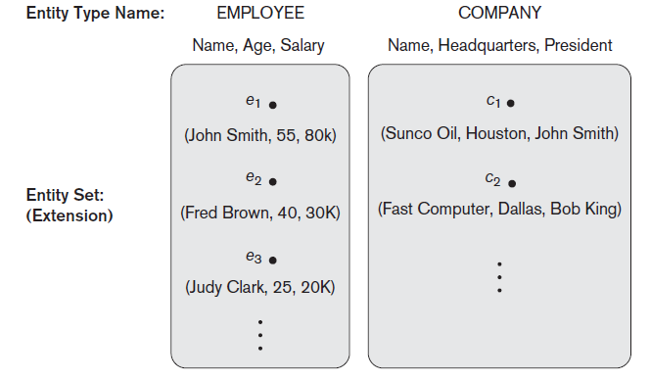
Entity Types and Entity Sets
An entity type defines a collection (or set) of entities that have the same attributes
Each entity type - described by its name and attributes
Example :
  Employee
  Company
The collection of all entities of a particular entity type in the database at any point in time is called an entity set
Figure : Two entity types, EMPLOYEE and COMPANY, and some member entities of
each.
Notes:
An entity set is a set of entities of the same type that share the same properties

Slide 16
Key Attributes of an Entity Type
An attribute of an entity type for which each entity must have a unique value is called a key attribute of the entity type
  For example, SSN of EMPLOYEE, SID of STUDENT
A key attribute may be composite
  Vehicle Number is a key of the CAR entity type with components (Number, State)
An entity type may have more than one key
  The CAR entity type may have two keys
    VehicleIdentificationNumber (popularly called VIN)
    VehicleTagNumber (Number, State), aka license plate number
A key for an entity set may have more than one attribute
Keys can be determined only from the meaning of the attributes in the entity type - Determined by the designers
An entity type have no key - weak entity type
Notes:
Key–an attribute or a collection of attributes whose value(s) uniquely identify an entity in the entity set

Slide 17
Retention Questions
Entities
Attributes
Types of Attributes
Entity types and Entity sets
Weak Entity type

Slide 18
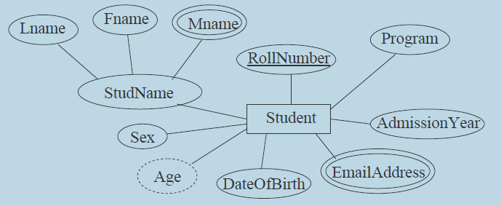
Displaying an Entity Type
In ER diagrams
  Entity type - rectangular box
  Attributes - ovals and are attached to their entity type by straight lines
  Composite attributes - ovals are attached to their component attributes by straight lines
  Multivalued attributes - double ovals
  Derived Attributes - dashed ovals
  Key attribute – underlined
Entity type - Schema or Intension
Entity set – Extension

Slide 19

Entity Type CAR with two keys and a corresponding Entity Set
Entity type
Entity Set

Slide 20
Values Sets (Domains) of Attributes
A set of values that may be assigned to the attributes of each individual entity, in an entity set is called the value set or domain
Example
  For employee entity, if age limit is 20 to 58, then the value set (domain) of attribute age consists of integer from 20 to 58.
  Age: Domain [ 20 – 58]
  The value set for name attribute is a set of alphabets and some special characters.
  Name: Domain [a – z], [A – Z], blank space, dot
  Gender : Domain [male, female]
Not displayed in ER diagram

Slide 21
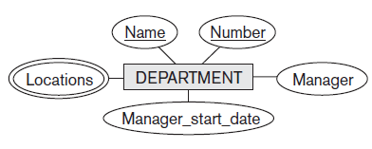
Initial Conceptual Design of the COMPANY Database
Entity type - DEPARTMENT
Attributes - Name, Number, Locations, Manager, and Manager_start_date.
Locations is the only multivalued attribute.
Both Name and Number are (separate) key attributes because each was specified to be unique.

Slide 22
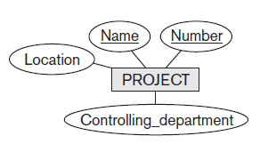
Initial Conceptual Design of the COMPANY Database
Entity type - PROJECT
Attributes - Name, Number, Location, and Controlling_department
Both Name and Number are (separate) key attributes

Slide 23
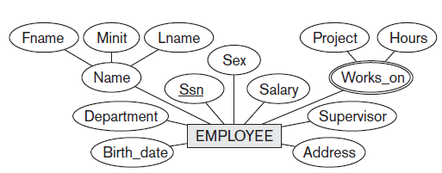
Initial Conceptual Design of the COMPANY Database
Entity type - EMPLOYEE
Attributes - Name, Ssn, Sex, Address, Salary, Birth_date, Department, and Supervisor.
Both Name and Address may be composite attributes

Slide 24
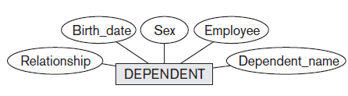
Initial Conceptual Design of the COMPANY Database
Entity type - DEPENDENT
Attributes - Employee, Dependent_name, Sex, Birth_date, and Relationship (to the employee)

Slide 25
Refining the Initial Design by Introducing Relationships
The initial design is typically not complete
Some aspects in the requirements will be represented as relationships
ER model has three main concepts
  Entities (and their entity types and entity sets)
  Attributes (simple, composite, multivalued)
  Relationships (and their relationship types and relationship sets)

Slide 26
Relationships
A relationship relates(associates) two or more distinct entities with a specific meaning
  For example: CUSTOMER ‘Jones’ has LOAN ‘L-23’
  EMPLOYEE Smith manages the Research DEPARTMENT
When two or more entities are associated with each other, we have an instance of a Relationship
  E.g.: student Ramesh enrolls in Discrete Mathematics course
Relationship enrolls has Student and Course as the participating entity sets
Formally, enrolls ⊆Student ×Course
  (s,c) ∈ enrolls ⇔Student ‘s’ has enrolled in Course ‘c’
  Tuples in enrolls–relationship instances
  Enrolls is called a relationship Type/Set

Slide 27
Operations on Sets
Union
Intersection
Complement
Cartesian Product
  The Cartesian Product of two sets A and B, denoted by A × B is the set of ordered pairs (a,b) where a ∈ A and b ∈ B
  ie., A x B = { (a,b) | a ∈ A ∧ b ∈ B }
Example:
  A = { a, b }, B = { 1, 2, 3 }
  A × B = { (a,1), (a,2), (a,3), (b,1), (b,2), (b,3) }
A subset R of the Cartesian product A × B is called a relation from the set A to the set B ( R ⊆ A X B )
  For example : R = { (a,1), (b, 2) }

Slide 28
Relationship Types and Sets
Relationships of the same type are grouped or typed into a Relationship Type
A Relationship Type R among n entity types E1, E2, ..., En defines a set of associations— or a relationship set—among entities from these entity types

Slide 29
Relationship Type vs. Relationship Set
Relationship Type
  Is the schema description of a relationship
  Identifies the relationship name and the participating entity types
  Also identifies certain relationship constraints
Relationship Set
  The current set of relationship instances represented in the database
  The current state of a relationship type

Slide 30
Relationship Instances
Mathematically,
The relationship set R is a set of relationship instances r_{i}, where each r_{i} associates n individual entities (e₁, e₂, ..., e_{n}), and each entity e_{j} in r_{i} is a member of entity set E_{j}, 1 ≤ j ≤ n
Informally, a relationship instance is an association of entities, with exactly one entity from each participating entity type
Hence, a relationship set is a mathematical relation on E₁, E₂, ..., E_{n}; alternatively, it can be defined as a subset of the Cartesian product of the entity sets E₁ × E₂ × ... × E_{n}

Slide 31
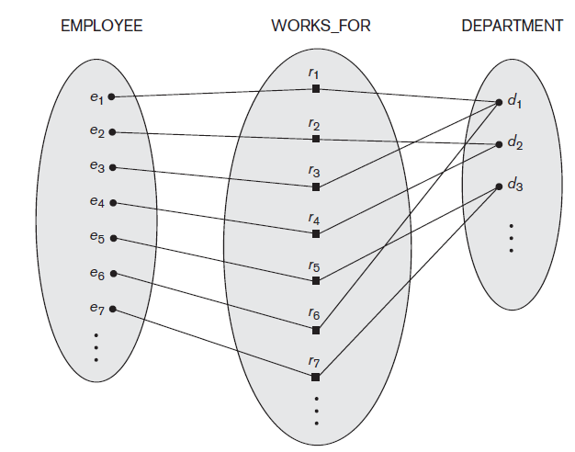
Relationship Types, Sets, and Instances
(e₁, d₁)
(e₂, d₂)
Figure : Some instances in the
WORKS_FOR relationship
set, which represents a
relationship type
WORKS_FOR between
EMPLOYEE and
DEPARTMENT.

Slide 32
Representation of Relationship Types
ER diagrams - Relationship types are displayed as diamond-shaped boxes, which are connected by straight lines to the rectangular boxes representing the participating entity types
Relationship name - displayed in the diamond-shaped box
WORKSFOR
EMPLOYEE
DEPARTMENT

Slide 33
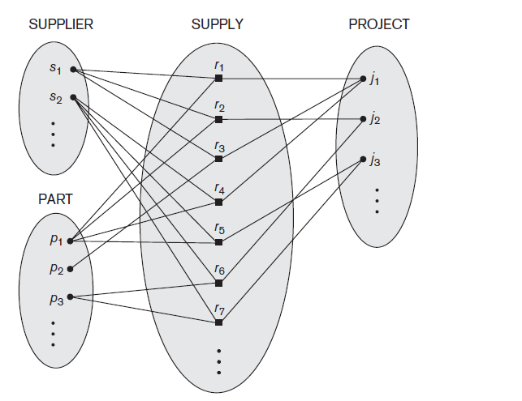
Degree of a Relationship Type
Degree of a relationship type - the number of participating entity types
  For example : WORKS_FOR relationship is of degree two
Binary - A relationship type of degree two
Ternary - A relationship type of degree three
Relationships can generally be of any degree (Degree n : n-ary)
Figure : Some relationship instances in the SUPPLY ternary relationship set.
Binary relationships are very common and widely used

Slide 34
Role Names and Recursive Relationships
Role name - signifies the role that a participating entity from the entity type plays in each relationship instance, and helps to explain what the relationship means
For example, in the WORKS_FOR relationship type, EMPLOYEE plays the role of employee or worker and DEPARTMENT plays the role of department or employer
Role names are not technically necessary in relationship types where all the participating entity types are distinct
If the same entity type participates more than once in a relationship type in different roles – Role names are essential
Such relationship types are called Recursive Relationships

Slide 35
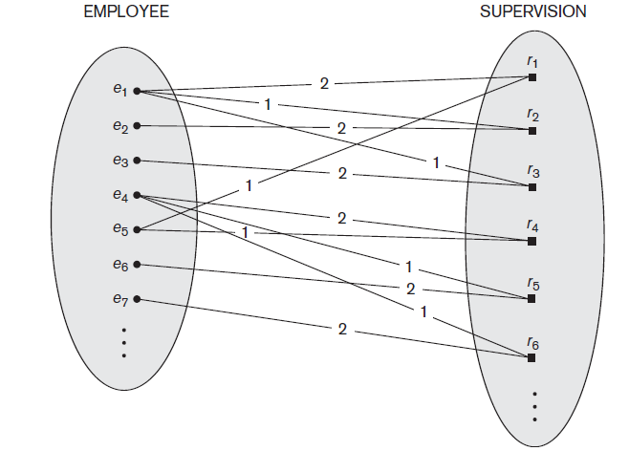
Role Names and Recursive Relationships
Figure :
A recursive relationship
SUPERVISION between
EMPLOYEE in the
supervisor role (1) and
EMPLOYEE in the
subordinate role (2)
The EMPLOYEE entity type participates twice in SUPERVISION: once in the role of supervisor (or boss), and once in the role of supervisee (or subordinate)
Notes:
lines marked ‘1’ represent the supervisor role, and those marked ‘2’ represent the supervisee role
e1 supervises e2 and e3, e4 supervises e6 and e7, and e5 supervises e1 and e4

Slide 36
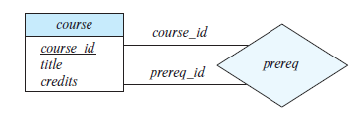
Recursive Relationships
An entity set relating to itself gives rise to a recursive relationship
One course (C1) is a prerequisite for another course (C2)
  The relationship prereqOf is an example of a recursive relationship on the entity Course
Role Names - Essential in case of recursive relationships
Can be optionally specified in non-recursive case
Role names

Slide 37
Constraints on Binary Relationship Types
Constraints - limit the possible combinations of entities that may participate in the corresponding relationship set
  are determined from the miniworld situation that the relationships represent
  For Example, if the company has a rule that each employee must work for exactly one department
Two main types of binary relationship constraints
  Cardinality ratio
  Participation

Slide 38
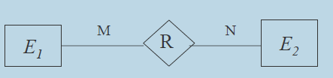
Cardinality Ratios for Binary Relationships
Cardinality Ratio - for a binary relationship
  specifies the maximum number of relationship instances that an entity can participate in
The number of entities from E₂ that an entity from E₁ can possibly be associated through R(and vice-versa) determines the cardinality ratio of R
Four possibilities are usually specified
  one-to-one (1:1)
  one-to-many (1:N)
  many-to-one (N:1)
  many-to-many (M:N)

Slide 39
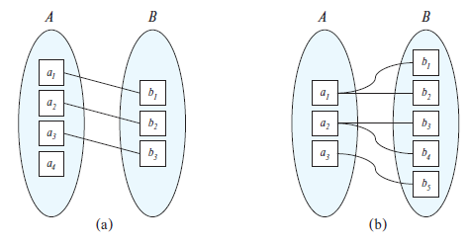
Mapping Cardinalities
One-to-one (1:1)
  An entity in A is associated with at most one entity in B, and an entity in B is associated with at most one entity in A
One-to-many (1:N)
  An entity in A is associated with any number (zero or more) of entities in B. An entity in B, however, can be associated with at most one entity in A
Figure : Mapping cardinalities (a) One-to-one (b) One-to-many

Slide 40
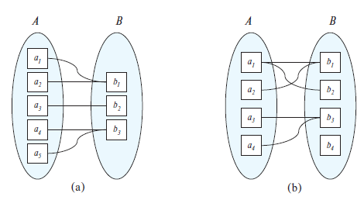
Mapping Cardinalities
Many-to-one (N:1)
  An entity in A is associated with at most one entity in B. An entity in B, however, can be associated with any number (zero or more) of entities in A
Many-to-many (M:N)
  An entity in A is associated with any number (zero or more) of entities in B, and an entity in B is associated with any number (zero or more) of entities in A
Figure : Mapping cardinalities (a) Many-to-one (b) Many-to-many

Slide 41
Cardinality Ratios for Binary Relationships
  1:1 (one-to-one)
  1:N (one-to-many)
  N:1 (many-to-one)
  M:N (many-to-many)
1
1
1
N
N
1
M
N
Elmasri and Navathe

Slide 42
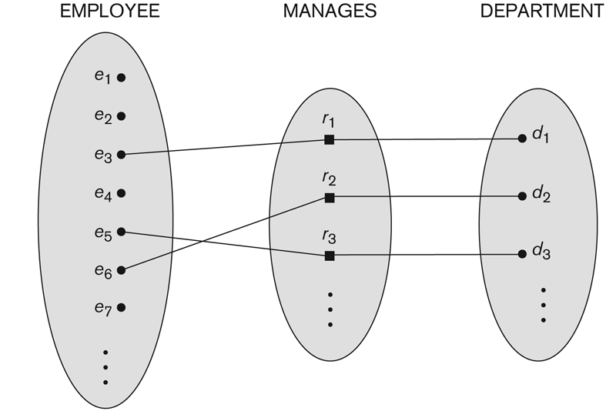
Cardinality Ratio - Example (one-to-one)
  An employee manages at most 1 department
  Each department has at most 1 manager
EMPLOYEE
DEPARTMENT
1
1

Slide 43
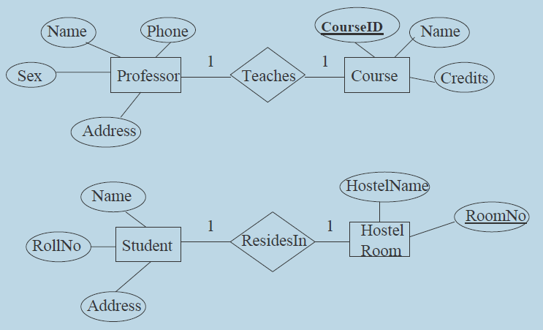
Cardinality Ratio - Example (one-to-one)

Slide 44
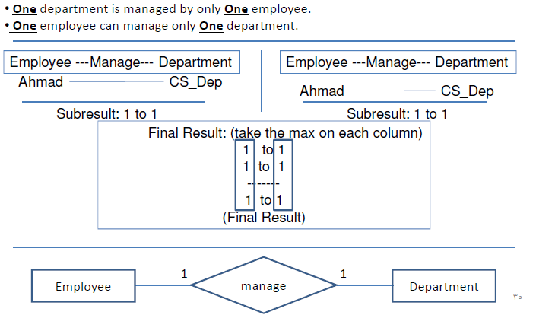
Cardinality Ratio - Example (one-to-one)

Slide 45
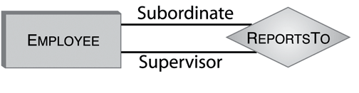

Cardinality Ratio –Example
(one-to-many)
  An employee can supervise many subordinates
  An employee has at most one supervisor
SUPERVISION
Roles
1 : supervisor
2 : subordinate

Slide 46
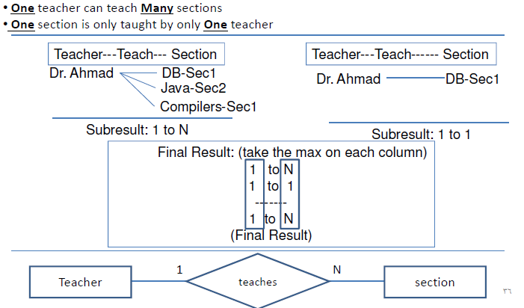
Cardinality Ratio –Example 1:N

Slide 47

Cardinality Ratio –Example
(many-to-one)
  A department can have more than one employees
  An employee works for at most 1 department
EMPLOYEE
DEPARTMENT
N
1
WORKS_FOR
Be careful where you put the 1 and N!!

Slide 48
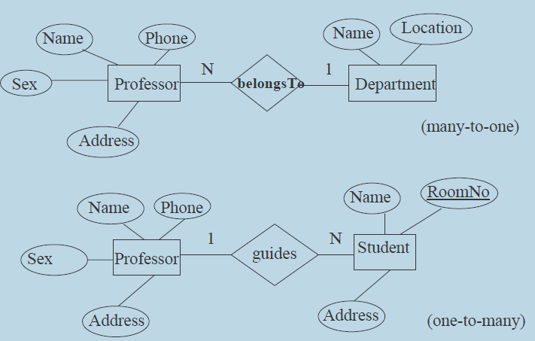
Cardinality Ratio –Example
(many-to-one/one-to-many)

Slide 49

Cardinality Ratio –Example
(many-to-many)
  An employee can work on more than one project
  A project can have more than one employee working on it
EMPLOYEE
PROJECT
M
N
WORKS_ON

Slide 50
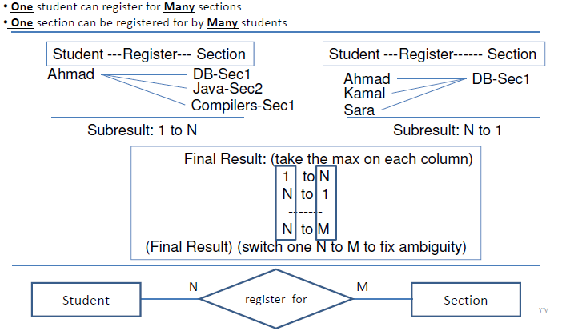
Cardinality Ratio –Example M:N

Slide 51
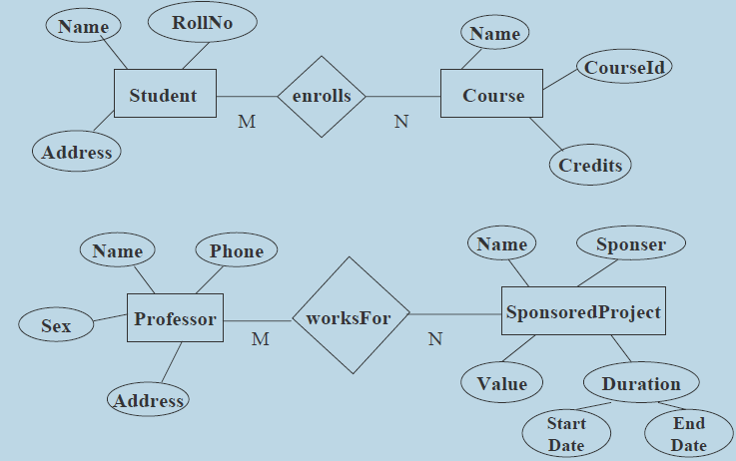
Cardinality Ratio –Example
(many-to-many)

Slide 52
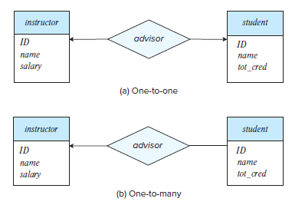
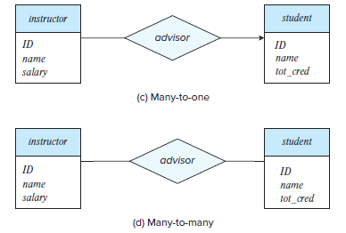
Cardinality Ratio –Example
In the E-R diagram notation (Silberschatz A., Korth H & Sudarshan S)
  cardinality constraints are also indicated
    by drawing either a directed line (→) or (one)
    an undirected line (—) between the relationship (many)

Slide 53
Participation Constraints and Existence Dependencies
Participation constraint (Elmasri and Navathe)
  specifies whether the existence of an entity depends on its being related to another entity via the relationship type
Specifies the minimum number of relationship instances that each entity can participate in - called the minimum cardinality constraint
  Cardinality Ratio and Participation Constraints - Structural Constraints of a relationship type
  They are called constraints as the data must satisfy them to be consistent with the requirements
  Two types of participation constraints - Total and Partial

Slide 54
Participation Constraints
  Total participation (also called existence dependency)
Partial Participation
Every entity must participate in at least 1 relationship
E
R
Some entities do not participate in any relationship
E
R

Slide 55
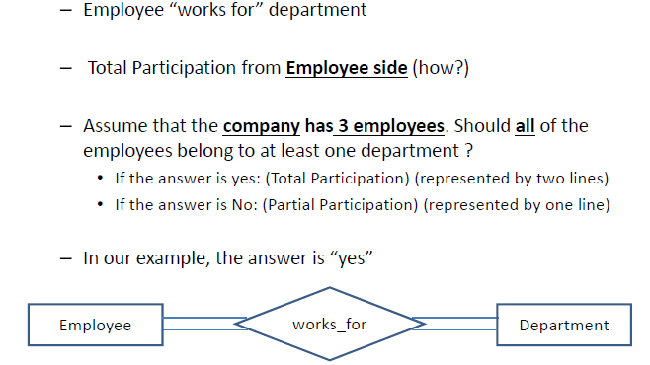
A way to think of Participation Constraints

Slide 56
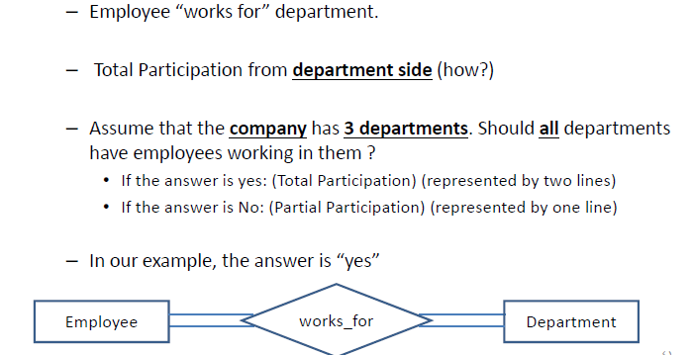
A way to think of Participation Constraints

Slide 57
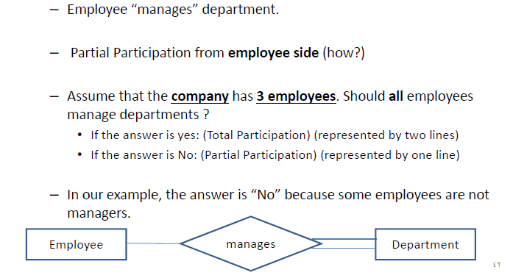
A way to think of Participation Constraints

Slide 58
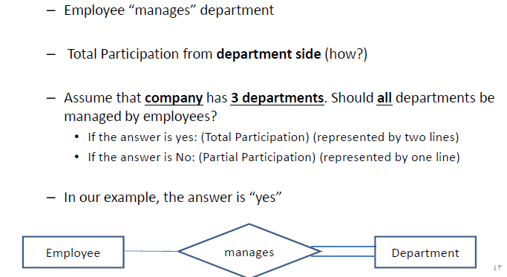
A way to think of Participation Constraints

Slide 59
Participation Constraints and Existence Dependencies
Total Participation
  If a company policy states that every employee must work for a department, then an employee entity can exist only if it participates in at least one WORKS_FOR relationship instance
  Hence, the participation of EMPLOYEE in WORKS_FOR is called total participation
Total participation - also called existence dependency
Partial Participation
  Every employee need not to manage a department, so the participation of EMPLOYEE in the MANAGES relationship type is partial

Slide 60
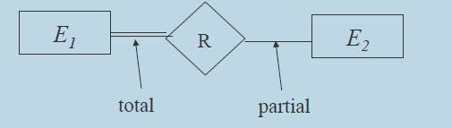
Participation Constraints
An entity set may participate in a relation either totally or partially (Silberschatz A., Korth H & Sudarshan S)
Total participation
  Every entity in the set is involved in some association (or tuple) of the relationship
Partial participation
  Not all entities in the set are involved in association (or tuples) of the relationship

Slide 61
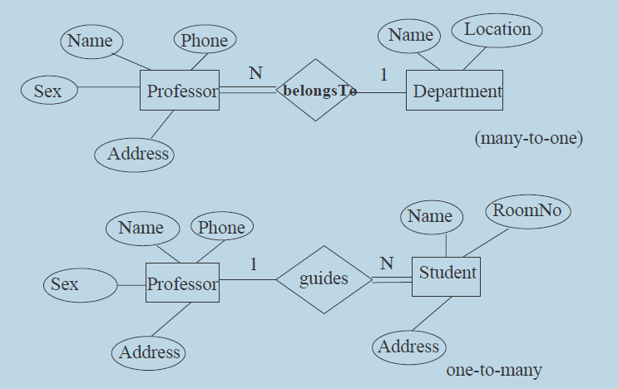
Example of Total/Partial Participation

Slide 62
Participation Constraint & Cardinality Ratio
  Every employee must work for at least one department
  Each department must have at least one employee
WORKS_FOR
EMPLOYEE
DEPARTMENT
WORKS_FOR
EMPLOYEE
DEPARTMENT
N
1
  Each employee works for exactly one department
  Each department has at least one employee

Slide 63
Participation Constraint & Cardinality Ratio
  Some employees do not manage any department
  Every department must have at least one manager
MANAGES
EMPLOYEE
DEPARTMENT
MANAGES
EMPLOYEE
DEPARTMENT
1
1
  Some employees manages a department and others don’t
  Every department has exactly one employee managing it

Slide 64
Alternative (min, max) notation for relationship structural constraints
Min-Max notation: pair of numbers (m,n) placed on the line connecting an entity to the relationship.
m: the minimum number of times a particular entity must appear in the relationship tuples at any point of time
  0 - partial participation
  ≥1 - total participation
n: similarly, the maximum number of times a particular entity can appear in the relationship tuples at any point of time
min=0, max=n (signifying no limit)
min ≤ max, min ≥ 0, max ≥ 1

Slide 65
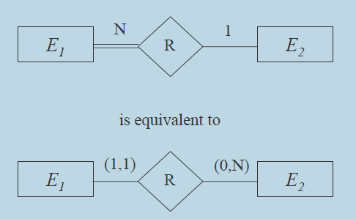
Comparing the Notations

Slide 66

(min, max) notation
Specify the minimum and maximum participation of an entity type in a relationship type
An employee can work for exactly one department but a department can have any number of employees
WORKS_FOR
EMPLOYEE
DEPARTMENT
N
1
is equivalent to:
    Specify (1,1) for participation of EMPLOYEE in WORKS_FOR
    Specify (1, n) for participation of DEPARTMENT in WORKS_FOR

Slide 67
(min, max) notation
  A department has exactly one manager and an employee can manage at most one department
MANAGES
EMPLOYEE
DEPARTMENT
1
1
is equivalent to:
  Specify (0,1) for participation of EMPLOYEE in MANAGES
  Specify (1,1) for participation of DEPARTMENT in MANAGES

Slide 68
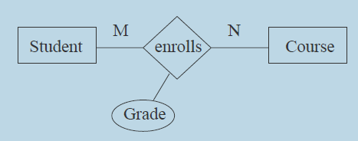
Attributes for Relationship Types
Relationship types can also have attributes, similar to those of entity types
Grade gives the letter grade (S,A,B, etc.) earned by the students for a course
  neither an attribute of Student nor that of Course

Slide 69
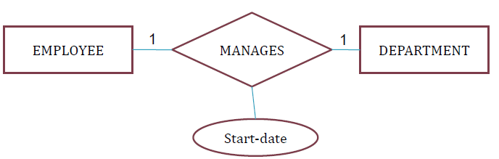
Attributes for Relationship Types
Attributes of 1:1 can be migrated to one of the participating entity types
Ex: Start-date attributes of MANAGES can be attribute of either DEPARTMENT or EMPLOYEE though conceptually it belongs to manages
The value of the Start-date can be determined separately either by participating DEPARTMENT entity or participating EMPLOYEE entity

Slide 70
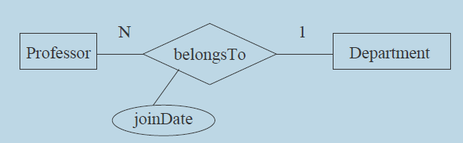
Attributes for Relationship Types
For a 1:N relationship type, a relationship attribute can be migrated only to the entity type on the N-side of the relationship
For N:1 relationship a relationship attribute can be migrated only to entity type on N-side of relationship
JoinDate attribute here can added only to Professor

Slide 71
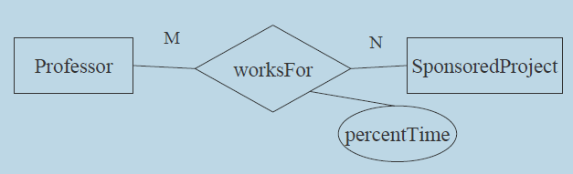
Attributes for Relationship Types
For M:N relationship types some attribute are determined by the combination of the participating entities, not by a single entity
Such attribute must be specified as the relationship attributes
Ex: PercentTime a professor works on SponsoredProject is determined by the Professor-SponsoredProject combination

Slide 72
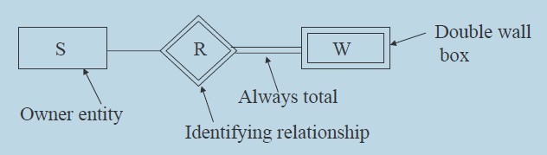
Weak Entity Types
Entity types that do not have key attributes of their own - weak entity types
Entity types that have a key attribute - are called strong entity types
Weak Entity Set - An entity set whose members owe their existence to some entity in a strong entity set
  Entities are not of independent existence
  Each weak entity is associated with some entity of the owner entity set through a special relationship
Notes:
weak entity type always has a total participation constraint (existence dependency) with respect to its identifying relationship because a weak entity cannot be identified without an owner entity

Slide 73
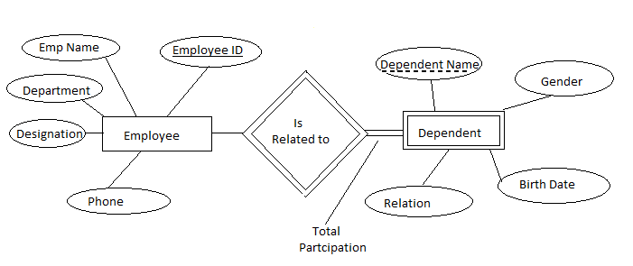

Weak Entity Sets -Example

Slide 74
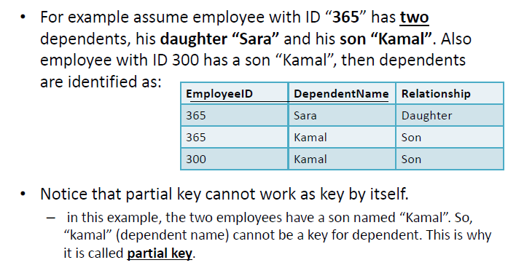
Weak Entity Sets -Example

Slide 75
Weak Entity Sets -Example
Total participation
Owner entity type
Weak entity type
DEPENDENTS_OF
EMPLOYEE
DEPENDENT
1
N
Relationship
Birth_date
SSN
Name
Sex
Identifying Relationship
Partial key
(dashed line)
Key for Dependent entity is (SSN, Name)

Slide 76
Retention Questions
Relationship Type, Sets and Instances
Degree of a Relationship Type
Role Names and Recursive Relationships
Constraints on Binary relationships
  Cardinality ratio – 1:1, 1:N, N:1, M:N
  Participation – Total and Partial
Attributes for Relationship Types
Weak Entity Types

Slide 77
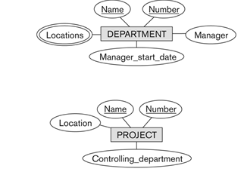
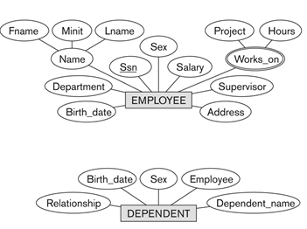
Refining the ER Design for the COMPANY Database
Entities
  Employee
  Department
  Project
  Dependent

Slide 78
Refining the ER Design for the COMPANY Database
Relationship Types
  MANAGES, a 1:1 relationship type between EMPLOYEE and DEPARTMENT, EMPLOYEE – partial, DEPARTMENT-total participation
  WORKS_FOR, a 1:N relationship type between DEPARTMENT and EMPLOYEE, Both participations are total
  CONTROLS, a 1:N relationship type between DEPARTMENT and PROJECT, PROJECT - total, DEPARTMENT – partial participation
  SUPERVISION, a 1:N relationship type between EMPLOYEE (in the supervisor role) and EMPLOYEE (in the supervisee role). Both participations are determined to be partial
  WORKS_ON, determined to be an M:N relationship type with attribute Hours, after the users indicate that a project can have several employees working on it. Both participations are determined to be total
  DEPENDENTS_OF, a 1:N relationship type between EMPLOYEE and DEPENDENT, which is also the identifying relationship for the weak entity type DEPENDENT. EMPLOYEE - partial, DEPENDENT - total

Slide 79
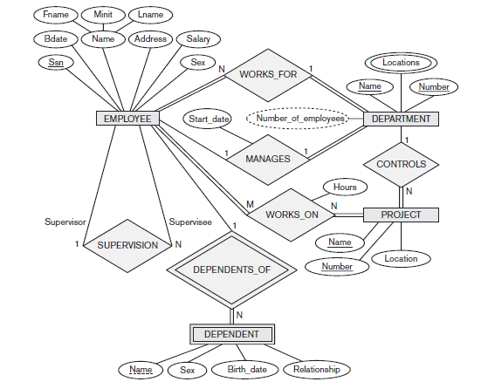

Slide 80


Slide 81

Summary of Notation for ER Diagrams

Slide 82
Relationship Types of Degree
Higher than Two
Relationship types of degree 2 - binary
Relationship types of degree 3 - ternary and
Relationship types of degree n - n-ary
In general, an n-ary relationship is not equivalent to ‘n’ binary relationships
Constraints are harder to specify for higher-degree relationships (n>2) than for binary relationships
In general, 3 binary relationships can represent different information than a single ternary relationship

Slide 83
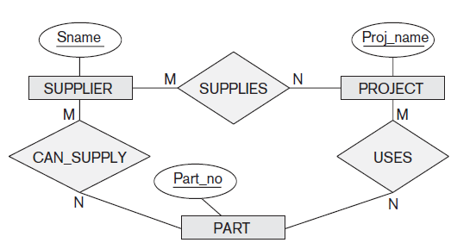
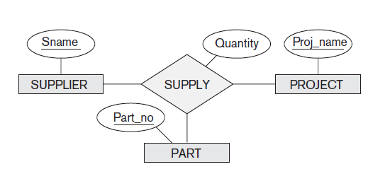
Relationship Types of Degree
Higher than Two
The relationship set of SUPPLY is a set of relationship instances (s, j, p), where s is a SUPPLIER who is currently supplying a PART p to a PROJECT j
The existence of three relationship instances (s, p), ( j, p), and (s, j) in CAN_SUPPLY, USES, and SUPPLIES, respectively, does not necessarily imply that an instance (s, j, p) exists in the ternary relationship SUPPLY, because the meaning is different

Slide 84
Example of a Ternary Relationship
(s, j )
(s, p )
Supplier | Project
Ace | R1
Ace | R2
Acme | R1
Acme | R2
Lowes | R1
Lowes | R2
Supplier | Part
Ace | T1
Ace | T2
Acme | T2
Acme | T1
Lowes | T1
Lowes | T2
(s, j, p )
Supplier | Project | Part
Ace | R1 | T1
Ace | R2 | T2
Acme | R1 | T2
Acme | R2 | T1
Lowes | R1 | T1
Lowes | R2 | T2
( j, p )
Project | Part
R1 | T1
R1 | T2
R2 | T1
R2 | T2

Slide 85
Relationship Types of Degree
Higher than Two
It is often tricky to decide whether a particular relationship should be represented as a relationship type of degree n or should be broken down into several relationship types of smaller degrees
Some database design tools are based on variations of the ER model that permit only binary relationships
  In this case, a ternary relationship such as SUPPLY must be represented as a weak entity type, with no partial key and with three identifying relationships.
  The three participating entity types SUPPLIER, PART, and PROJECT are together the owner entity types

Slide 86
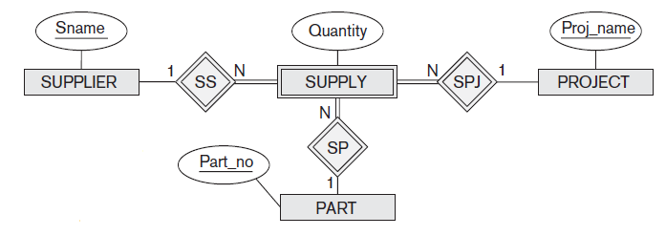
Relationship Types of Degree
Higher than Two
An entity in the weak entity type SUPPLY is identified by the combination of its three owner entities from SUPPLIER, PART, and PROJECT

